Slide 1
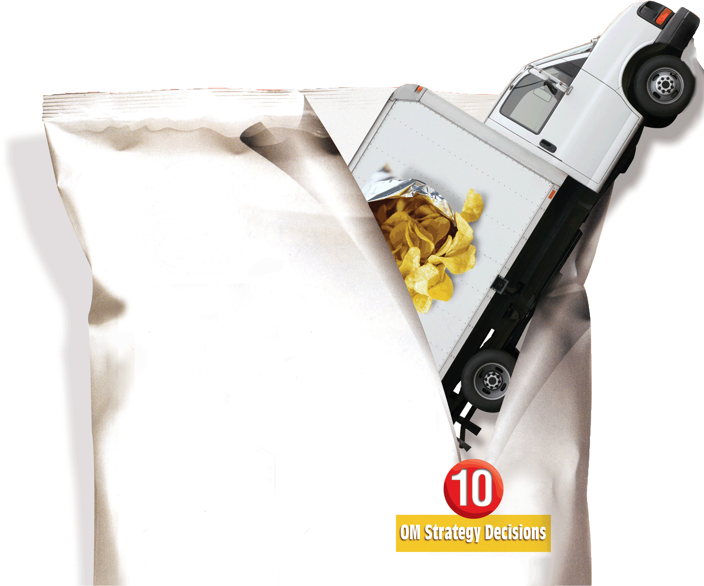
13
Aggregate Planning
PowerPoint presentation to accompany
Heizer and Render
Operations Management, 10e
Principles of Operations Management, 8e
PowerPoint slides by Jeff Heyl

Slide 2
Outline
Global Company Profile: Frito-Lay
The Planning Process
  Planning Horizons
The Nature of Aggregate Planning
Aggregate Planning Strategies
  Capacity Options
  Demand Options
  Mixing Options to Develop a Plan

Slide 3
Outline – Continued
Methods for Aggregate Planning
  Graphical Methods
  Mathematical Approaches
  Comparison of Aggregate Planning Methods

Slide 4
Outline – Continued
Aggregate Planning in Services
  Restaurants
  Hospitals
  National Chains of Small Service Firms
  Miscellaneous Services
  Airline Industry
Yield Management

Slide 5
Learning Objectives
When you complete this chapter you should be able to:
Define aggregate planning
Identify optional strategies for developing an aggregate plan
Prepare a graphical aggregate plan

Slide 6
Learning Objectives
When you complete this chapter you should be able to:
Solve an aggregate plan via the transportation method of linear programming
Understand and solve a yield management problem

Slide 7
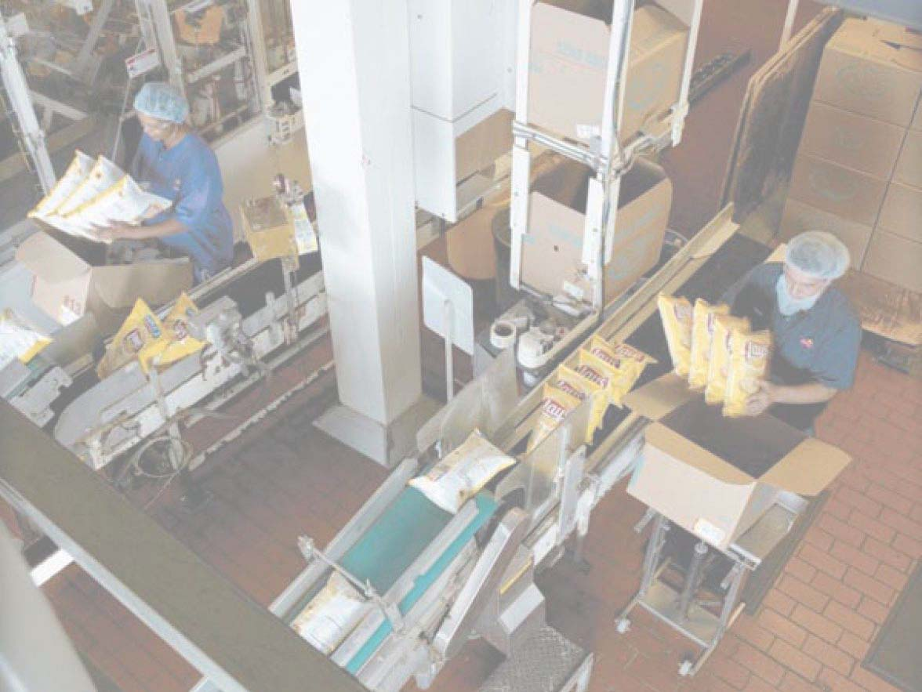
Frito-Lay
More than three dozen brands, 15 brands sell more than $100 million annually, 7 sell over $1 billion
Planning processes covers 3 to 18 months
Unique processes and specially designed equipment
High fixed costs require high volumes and high utilization

Slide 8
Frito-Lay
Demand profile based on historical sales, forecasts, innovations, promotion, local demand data
Match total demand to capacity, expansion plans, and costs
Quarterly aggregate plan goes to 38 plants in 18 regions
Each plant develops 4-week plan for product lines and production runs

Slide 9
Aggregate Planning
The objective of aggregate planning is to meet forecasted demand while minimizing cost over the planning period

Slide 10
The Planning Process
Determine the quantity and timing of production for the intermediate future
Objective is to minimize cost over the planning period by adjusting
  Production rates
  Labor levels
  Inventory levels
  Overtime work
  Subcontracting rates
  Other controllable variables

Slide 11
Aggregate Planning
Required for aggregate planning
A logical overall unit for measuring sales and output
A forecast of demand for an intermediate planning period in these aggregate terms
A method for determining costs
A model that combines forecasts and costs so that scheduling decisions can be made for the planning period

Slide 12
Planning Horizons
Long-range plans
(over one year)
Research and Development
New product plans
Capital investments
Facility location/expansion
Top executives
Intermediate-range plans
(3 to 18 months)
Sales planning
Production planning and budgeting
Setting employment, inventory, subcontracting levels
Analyzing operating plans
Operations managers
Short-range plans
(up to 3 months)
Job assignments
Ordering
Job scheduling
Dispatching
Overtime
Part-time help
Operations managers, supervisors, foremen
Responsibility
Planning tasks and horizon
Figure 13.1

Slide 13
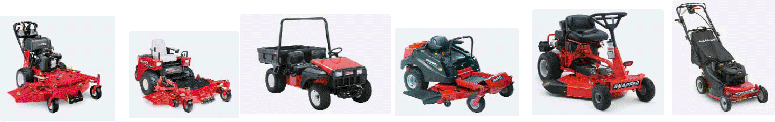
Aggregate Planning
Quarter 1
Jan Feb Mar
150,000 120,000 110,000
Quarter 2
Apr May Jun
100,000 130,000 150,000
Quarter 3
Jul Aug Sep
180,000 150,000 140,000

Slide 14
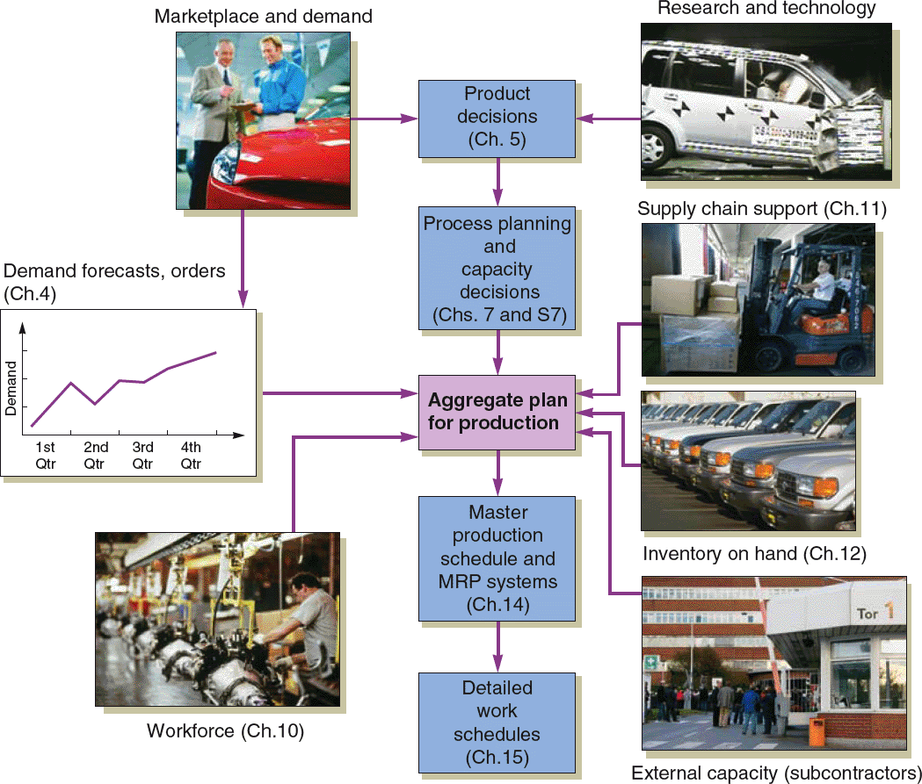
Aggregate Planning
Figure 13.2

Slide 15
Aggregate Planning
Combines appropriate resources into general terms
Part of a larger production planning system
Disaggregation breaks the plan down into greater detail
Disaggregation results in a master production schedule

Slide 16
Aggregate Planning Strategies
Use inventories to absorb changes in demand
Accommodate changes by varying workforce size
Use part-timers, overtime, or idle time to absorb changes
Use subcontractors and maintain a stable workforce
Change prices or other factors to influence demand

Slide 17
Capacity Options
Changing inventory levels
  Increase inventory in low demand periods to meet high demand in the future
  Increases costs associated with storage, insurance, handling, obsolescence, and capital investment
  Shortages may mean lost sales due to long lead times and poor customer service

Slide 18
Capacity Options
Varying workforce size by hiring or layoffs
  Match production rate to demand
  Training and separation costs for hiring and laying off workers
  New workers may have lower productivity
  Laying off workers may lower morale and productivity

Slide 19
Capacity Options
Varying production rate through overtime or idle time
  Allows constant workforce
  May be difficult to meet large increases in demand
  Overtime can be costly and may drive down productivity
  Absorbing idle time may be difficult

Slide 20
Capacity Options
Subcontracting
  Temporary measure during periods of peak demand
  May be costly
  Assuring quality and timely delivery may be difficult
  Exposes your customers to a possible competitor

Slide 21
Capacity Options
Using part-time workers
  Useful for filling unskilled or low skilled positions, especially in services

Slide 22
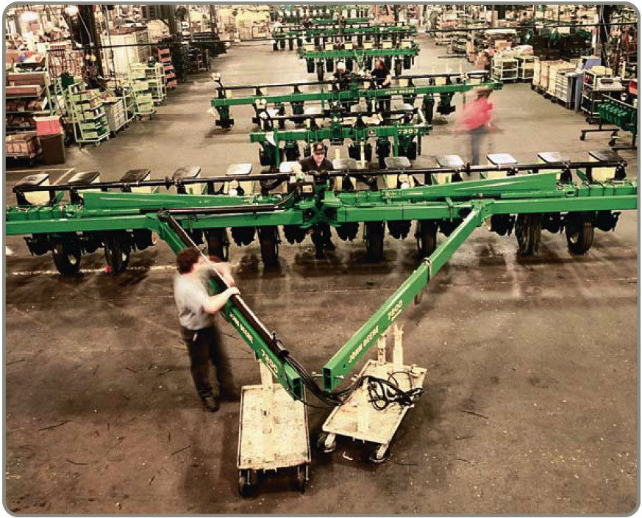
Demand Options
Influencing demand
  Use advertising or promotion to increase demand in low periods
  Attempt to shift
  demand to slow
  periods
  May not be
  sufficient to
  balance demand
  and capacity

Slide 23
Demand Options
Back ordering during high- demand periods
  Requires customers to wait for an order without loss of goodwill or the order
  Most effective when there are few if any substitutes for the product or service
  Often results in lost sales

Slide 24
Demand Options
Counterseasonal product and service mixing
  Develop a product mix of counterseasonal items
  May lead to products or services outside the company’s areas of expertise

Slide 25
Aggregate Planning Options
Option | Advantages | Disadvantages | Some Comments
Changing inventory levels | Changes in human resources are gradual or none; no abrupt production changes. | Inventory holding cost may increase. Shortages may result in lost sales. | Applies mainly to production, not service, operations.
Varying workforce size by hiring or layoffs | Avoids the costs of other alternatives. | Hiring, layoff, and training costs may be significant. | Used where size of labor pool is large.
Table 13.1

Slide 26
Aggregate Planning Options
Option | Advantages | Disadvantages | Some Comments
Varying production rates through overtime or idle time | Matches seasonal fluctuations without hiring/ training costs. | Overtime premiums; tired workers; may not meet demand. | Allows flexibility within the aggregate plan.
Sub-contracting | Permits flexibility and smoothing of the firm’s output. | Loss of quality control; reduced profits; loss of future business. | Applies mainly in production settings.
Table 13.1

Slide 27
Aggregate Planning Options
Option | Advantages | Disadvantages | Some Comments
Using part-time workers | Is less costly and more flexible than full-time workers. | High turnover/ training costs; quality suffers; scheduling difficult. | Good for unskilled jobs in areas with large temporary labor pools.
Influencing demand | Tries to use excess capacity. Discounts draw new customers. | Uncertainty in demand. Hard to match demand to supply exactly. | Creates marketing ideas. Overbooking used in some businesses.
Table 13.1

Slide 28
Aggregate Planning Options
Option | Advantages | Disadvantages | Some Comments
Back ordering during high-demand periods | May avoid overtime. Keeps capacity constant. | Customer must be willing to wait, but goodwill is lost. | Many companies back order.
Counter-seasonal product and service mixing | Fully utilizes resources; allows stable workforce. | May require skills or equipment outside the firm’s areas of expertise. | Risky finding products or services with opposite demand patterns.
Table 13.1

Slide 29
Methods for Aggregate Planning
A mixed strategy may be the best way to achieve minimum costs
There are many possible mixed strategies
Finding the optimal plan is not always possible

Slide 30
Mixing Options to
Develop a Plan
Chase strategy
  Match output rates to demand forecast for each period
  Vary workforce levels or vary production rate
  Favored by many service organizations

Slide 31
Mixing Options to
Develop a Plan
Level strategy
  Daily production is uniform
  Use inventory or idle time as buffer
  Stable production leads to better quality and productivity
Some combination of capacity options, a mixed strategy, might be the best solution

Slide 32
Graphical Methods
Popular techniques
Easy to understand and use
Trial-and-error approaches that do not guarantee an optimal solution
Require only limited computations

Slide 33
Graphical Methods
Determine the demand for each period
Determine the capacity for regular time, overtime, and subcontracting each period
Find labor costs, hiring and layoff costs, and inventory holding costs
Consider company policy on workers and stock levels
Develop alternative plans and examine their total costs

Slide 34
Roofing Supplier Example 1
Month | Expected Demand | Production Days | Demand Per Day (computed)
Jan | 900 | 22 | 41
Feb | 700 | 18 | 39
Mar | 800 | 21 | 38
Apr | 1,200 | 21 | 57
May | 1,500 | 22 | 68
June | 1,100 | 20 | 55
 | 6,200 | 124
Table 13.2
Average requirement
Total expected demand
Number of production days
=
6,200
124
= = 50 units per day

Slide 35
Roofing Supplier Example 1
Forecast demand
70 –
60 –
50 –
40 –
30 –
0 –
Level production using average monthly forecast demand
Production rate per working day
Jan Feb Mar Apr May June = Month
⬇ ⬇ ⬇ ⬇ ⬇ ⬇
22 18 21 21 22 20 = Number of
working days
Figure 13.3

Slide 36
Roofing Supplier Example 2
Cost Information
Inventory carrying cost | $ 5 per unit per month
Subcontracting cost per unit | $20 per unit
Average pay rate | $10 per hour ($80 per day)
Overtime pay rate | $17 per hour (above 8 hours per day)
Labor-hours to produce a unit | 1.6 hours per unit
Cost of increasing daily production rate (hiring and training) | $300 per unit
Cost of decreasing daily production rate (layoffs) | $600 per unit
Plan 1 – constant workforce
Table 13.3

Slide 37
Roofing Supplier Example 2
Month | Production Days | Production at 50 Units per Day | Demand Forecast | Monthly Inventory Change | Ending Inventory
Jan | 22 | 1,100 | 900 | +200 | 200
Feb | 18 | 900 | 700 | +200 | 400
Mar | 21 | 1,050 | 800 | +250 | 650
Apr | 21 | 1,050 | 1,200 | -150 | 500
May | 22 | 1,100 | 1,500 | -400 | 100
June | 20 | 1,000 | 1,100 | -100 | 0
 |  |  |  |  | 1,850
Cost Information
Inventory carrying cost | $ 5 per unit per month
Subcontracting cost per unit | $20 per unit
Average pay rate | $10 per hour ($80 per day)
Overtime pay rate | $17 per hour (above 8 hours per day)
Labor-hours to produce a unit | 1.6 hours per unit
Cost of increasing daily production rate (hiring and training) | $300 per unit
Cost of decreasing daily production rate (layoffs) | $600 per unit
Total units of inventory carried over from one
month to the next = 1,850 units
Workforce required to produce 50 units per day = 10 workers
Plan 1 – constant workforce
Table 13.3

Slide 38
Roofing Supplier Example 2
Month | Production Days | Production at 50 Units per Day | Demand Forecast | Monthly Inventory Change | Ending Inventory
Jan | 22 | 1,100 | 900 | +200 | 200
Feb | 18 | 900 | 700 | +200 | 400
Mar | 21 | 1,050 | 800 | +250 | 650
Apr | 21 | 1,050 | 1,200 | -150 | 500
May | 22 | 1,100 | 1,500 | -400 | 100
June | 20 | 1,000 | 1,100 | -100 | 0
 |  |  |  |  | 1,850
Cost Information
Inventory carrying cost | $ 5 per unit per month
Subcontracting cost per unit | $20 per unit
Average pay rate | $10 per hour ($80 per day)
Overtime pay rate | $17 per hour (above 8 hours per day)
Labor-hours to produce a unit | 1.6 hours per unit
Cost of increasing daily production rate (hiring and training) | $300 per unit
Cost of decreasing daily production rate (layoffs) | $600 per unit
Costs |  | Calculations
Inventory carrying | $9,250 | (= 1,850 units carried x $5 per unit)
Regular-time labor | 99,200 | (= 10 workers x $80 per day x 124 days)
Other costs (overtime, hiring, layoffs, subcontracting) | 0
Total cost | $108,450
Total units of inventory carried over from one
month to the next = 1,850 units
Workforce required to produce 50 units per day = 10 workers
Plan 1 – constant workforce
Table 13.3

Slide 39
Roofing Supplier Example 2
7,000 –
6,000 –
5,000 –
4,000 –
3,000 –
2,000 –
1,000 –
–
Reduction
of inventory
Cumulative level production using average monthly forecast requirements
6,200 units
Cumulative demand units
Cumulative forecast requirements
Excess inventory
Jan Feb Mar Apr May June
Figure 13.4

Slide 40
Roofing Supplier Example 3
Month | Expected Demand | Production Days | Demand Per Day (computed)
Jan | 900 | 22 | 41
Feb | 700 | 18 | 39
Mar | 800 | 21 | 38
Apr | 1,200 | 21 | 57
May | 1,500 | 22 | 68
June | 1,100 | 20 | 55
 | 6,200 | 124
Plan 2 – subcontracting
Table 13.2
Minimum requirement = 38 units per day

Slide 41
Roofing Supplier Example 3
Forecast demand
70 –
60 –
50 –
40 –
30 –
0 –
Level production using lowest monthly forecast demand
Production rate per working day
Jan Feb Mar Apr May June = Month
⬇ ⬇ ⬇ ⬇ ⬇ ⬇
22 18 21 21 22 20 = Number of
working days

Slide 42
Roofing Supplier Example 3
Cost Information
Inventory carrying cost | $ 5 per unit per month
Subcontracting cost per unit | $20 per unit
Average pay rate | $10 per hour ($80 per day)
Overtime pay rate | $17 per hour (above 8 hours per day)
Labor-hours to produce a unit | 1.6 hours per unit
Cost of increasing daily production rate (hiring and training) | $300 per unit
Cost of decreasing daily production rate (layoffs) | $600 per unit
Table 13.3

Slide 43
Roofing Supplier Example 3
Cost Information
Inventory carry cost | $ 5 per unit per month
Subcontracting cost per unit | $10 per unit
Average pay rate | $ 5 per hour ($40 per day)
Overtime pay rate | $ 7 per hour (above 8 hours per day)
Labor-hours to produce a unit | 1.6 hours per unit
Cost of increasing daily production rate (hiring and training) | $300 per unit
Cost of decreasing daily production rate (layoffs) | $600 per unit
In-house production = 38 units per day
x 124 days
= 4,712 units
Subcontract units = 6,200 - 4,712
= 1,488 units
Table 13.3

Slide 44
Roofing Supplier Example 3
Cost Information
Inventory carry cost | $ 5 per unit per month
Subcontracting cost per unit | $10 per unit
Average pay rate | $ 5 per hour ($40 per day)
Overtime pay rate | $ 7 per hour (above 8 hours per day)
Labor-hours to produce a unit | 1.6 hours per unit
Cost of increasing daily production rate (hiring and training) | $300 per unit
Cost of decreasing daily production rate (layoffs) | $600 per unit
In-house production = 38 units per day
x 124 days
= 4,712 units
Subcontract units = 6,200 - 4,712
= 1,488 units
Costs |  | Calculations
Regular-time labor | $75,392 | (= 7.6 workers x $80 per day x 124 days)
Subcontracting | 29,760 | (= 1,488 units x $20 per unit)
Total cost | $105,152
Table 13.3

Slide 45
Roofing Supplier Example 4
Month | Expected Demand | Production Days | Demand Per Day (computed)
Jan | 900 | 22 | 41
Feb | 700 | 18 | 39
Mar | 800 | 21 | 38
Apr | 1,200 | 21 | 57
May | 1,500 | 22 | 68
June | 1,100 | 20 | 55
 | 6,200 | 124
Table 13.2
Plan 3 – hiring and layoffs
Production = Expected Demand

Slide 46
Roofing Supplier Example 4
Forecast demand and monthly production
70 –
60 –
50 –
40 –
30 –
0 –
Production rate per working day
Jan Feb Mar Apr May June = Month
⬇ ⬇ ⬇ ⬇ ⬇ ⬇
22 18 21 21 22 20 = Number of
working days

Slide 47
Roofing Supplier Example 4
Cost Information
Inventory carrying cost | $ 5 per unit per month
Subcontracting cost per unit | $20 per unit
Average pay rate | $10 per hour ($80 per day)
Overtime pay rate | $17 per hour (above 8 hours per day)
Labor-hours to produce a unit | 1.6 hours per unit
Cost of increasing daily production rate (hiring and training) | $300 per unit
Cost of decreasing daily production rate (layoffs) | $600 per unit
Table 13.3

Slide 48
Roofing Supplier Example 4
Month | Forecast (units) | Daily Prod Rate | Basic Production Cost (demand x 1.6 hrs/unit x $10/hr) | Extra Cost of Increasing Production (hiring cost) | Extra Cost of Decreasing Production (layoff cost) | Total Cost
Jan | 900 | 41 | $ 14,400 | — | — | $ 14,400
Feb | 700 | 39 | 11,200 | — | $1,200 (= 2 x $600) | 12,400
Mar | 800 | 38 | 12,800 | — | $600 (= 1 x $600) | 13,400
Apr | 1,200 | 57 | 19,200 | $5,700 (= 19 x $300) | — | 24,900
May | 1,500 | 68 | 24,000 | $3,300 (= 11 x $300) | — | 24,300
June | 1,100 | 55 | 17,600 | — | $7,800 (= 13 x $600) | 25,400
 |  |  | $99,200 | $9,000 | $9,600 | $117,800
Cost Information
Inventory carrying cost | $ 5 per unit per month
Subcontracting cost per unit | $10 per unit
Average pay rate | $ 5 per hour ($40 per day)
Overtime pay rate | $ 7 per hour (above 8 hours per day)
Labor-hours to produce a unit | 1.6 hours per unit
Cost of increasing daily production rate (hiring and training) | $300 per unit
Cost of decreasing daily production rate (layoffs) | $600 per unit
Table 13.3
Table 13.4

Slide 49
Comparison of Three Plans
Cost | Plan 1 | Plan 2 | Plan 3
Inventory carrying | $ 9,250 | $ 0 | $ 0
Regular labor | 99,200 | 75,392 | 99,200
Overtime labor | 0 | 0 | 0
Hiring | 0 | 0 | 9,000
Layoffs | 0 | 0 | 9,600
Subcontracting | 0 | 29,760 | 0
Total cost | $108,450 | $105,152 | $117,800
Plan 2 is the lowest cost option
Table 13.5

Slide 50
Mathematical Approaches
Useful for generating strategies
  Transportation Method of Linear Programming
    Produces an optimal plan
  Management Coefficients Model
    Model built around manager’s experience and performance
  Other Models
    Linear Decision Rule
    Simulation

Slide 51
Transportation Method
Sales Period
Mar Apr May
Demand 800 1,000 750
Capacity:
Regular 700 700 700
Overtime 50 50 50
Subcontracting 150 150 130
Beginning inventory 100
tires
Costs
Regular time $40 per tire
Overtime $50 per tire
Subcontracting $70 per tire
Carrying $ 2 per tire per month
Table 13.6

Slide 52
Transportation Example
Important points
Carrying costs are $2/tire/month. If goods are made in one period and held over to the next, holding costs are incurred
Supply must equal demand, so a dummy column called “unused capacity” is added
Because back ordering is not viable in this example, cells that might be used to satisfy earlier demand are not available

Slide 53
Transportation Example
Important points
Quantities in each column designate the levels of inventory needed to meet demand requirements
In general, production should be allocated to the lowest cost cell available without exceeding unused capacity in the row or demand in the column

Slide 54
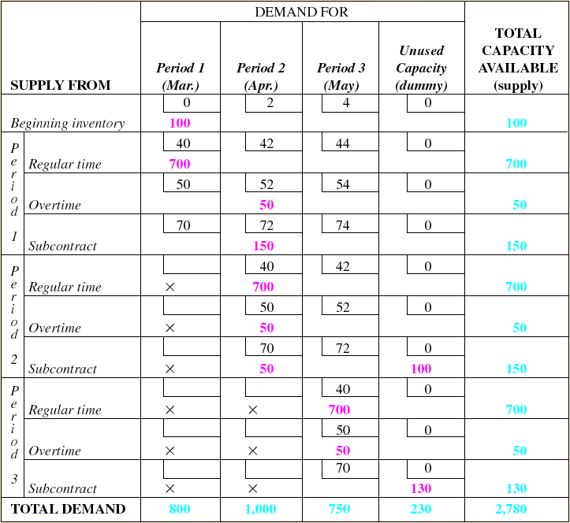
Transportation Example
Table 13.7

Slide 55
Management Coefficients Model
Builds a model based on manager’s experience and performance
A regression model is constructed to define the relationships between decision variables
Objective is to remove inconsistencies in decision making

Slide 56
Other Models
Linear Decision Rule
Minimizes costs using quadratic cost curves
Operates over a particular time period
Simulation
Uses a search procedure to try different combinations of variables
Develops feasible but not necessarily optimal solutions

Slide 57
Summary of Aggregate Planning Methods
Techniques | Solution Approaches | Important Aspects
Graphical methods | Trial and error | Simple to understand and easy to use. Many solutions; one chosen may not be optimal.
Transportation method of linear programming | Optimization | LP software available; permits sensitivity analysis and new constraints; linear functions may not be realistic.
Table 13.8

Slide 58
Summary of Aggregate Planning Methods
Techniques | Solution Approaches | Important Aspects
Management coefficients model | Heuristic | Simple, easy to implement; tries to mimic manager’s decision process; uses regression.
Simulation | Change parameters | Complex; may be difficult to build and for managers to understand.
Table 13.8

Slide 59
Aggregate Planning in Services
Controlling the cost of labor is critical
Accurate scheduling of labor-hours to assure quick response to customer demand
An on-call labor resource to cover unexpected demand
Flexibility of individual worker skills
Flexibility in rate of output or hours of work

Slide 60
Five Service Scenarios
Restaurants
  Smoothing the production process
  Determining the optimal workforce size
Hospitals
  Responding to patient demand

Slide 61
Five Service Scenarios
National Chains of Small Service Firms
  Planning done at national level and at local level
Miscellaneous Services
  Plan human resource requirements
  Manage demand

Slide 62
Law Firm Example
Labor-Hours Required Capacity Constraints
(2) (3) (4) (5) (6)
(1) Forecasts Maximum Number of
Category of Best Likely Worst Demand in Qualified
Legal Business (hours) (hours) (hours) People Personnel
Trial work 1,800 1,500 1,200 3.6 4
Legal research 4,500 4,000 3,500 9.0 32
Corporate law 8,000 7,000 6,500 16.0 15
Real estate law 1,700 1,500 1,300 3.4 6
Criminal law 3,500 3,000 2,500 7.0 12
Total hours 19,500 17,000 15,000
Lawyers needed 39 34 30
Table 13.9

Slide 63
Five Service Scenarios
Airline industry
  Extremely complex planning problem
  Involves number of flights, number of passengers, air and ground personnel, allocation of seats to fare classes
  Resources spread through the entire system

Slide 64
Yield Management
Allocating resources to customers at prices that will maximize yield or revenue
  Service or product can be sold in advance of consumption
  Demand fluctuates
  Capacity is relatively fixed
  Demand can be segmented
  Variable costs are low and fixed costs are high

Slide 65
Yield Management Example
Room sales
Demand Curve
Potential customers exist who are willing to pay more than the $15 variable cost of the room, but not $150
100
Passed-up contribution
Some customers who paid $150 were actually willing to pay more for the room
50
Total
$ contribution
= (Price) x (50
rooms)
= ($150 - $15)
x (50)
= $6,750
Money left on the table
$15
Variable cost
of room
$150
Price charged for room
Price
Figure 13.5

Slide 66
Yield Management Example
Room sales
Demand Curve
Total $ contribution =
(1st price) x 30 rooms + (2nd price) x 30 rooms =
($100 - $15) x 30 + ($200 - $15) x 30 =
$2,550 + $5,550 = $8,100
100
60
30
$15
Variable cost
of room
$100
Price 1
for room
$200
Price 2
for room
Price
Figure 13.6

Slide 67
Yield Management Matrix
Price
Tend to be fixed Tend to be variable
Quadrant 1: Quadrant 2:
Movies Hotels
Stadiums/arenas Airlines
Convention centers Rental cars
Hotel meeting space Cruise lines
Quadrant 3: Quadrant 4:
Restaurants Continuing care
Golf courses hospitals
Internet service
providers
Duration of use
Tend to be Tend to be
Uncertain predictable
Figure 13.7

Slide 68
Making Yield Management Work
Multiple pricing structures must be feasible and appear logical to the customer
Forecasts of the use and duration of use
Changes in demand

Slide 69

All rights reserved. No part of this publication may be reproduced, stored in a retrieval system, or transmitted, in any form or by any means, electronic, mechanical, photocopying, recording, or otherwise, without the prior written permission of the publisher.
Printed in the United States of America.

